Slide 1
Citizenship Class
Session 1 and 2 Review
**Watch this video before moving on to Session 3

Slide 2
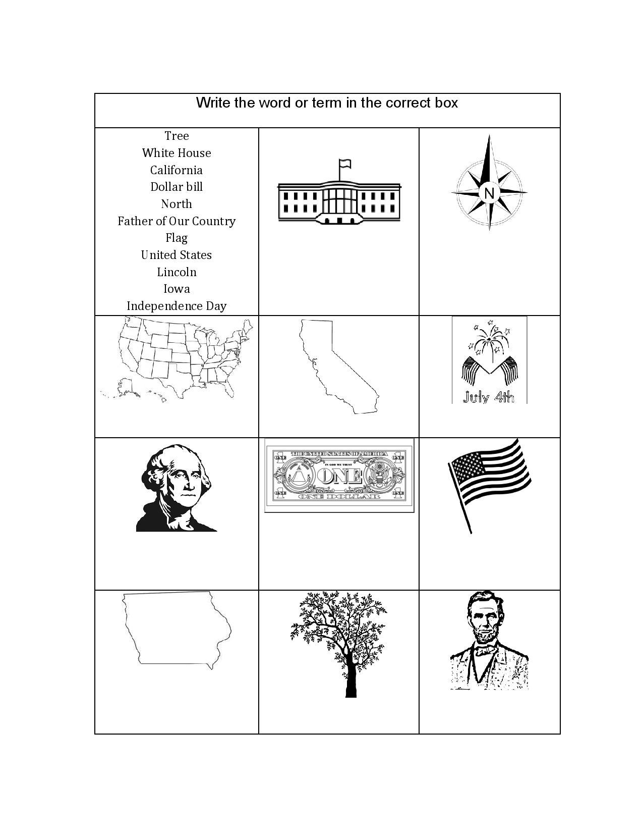
Matching Activity
Tree

Slide 3
Matching Activity
White House
North
United States
California
Independence Day
Father of Our Country
Dollar Bill
Flag
Iowa
Tree
Lincoln

Slide 4
Review Session 2 Homework
I want to be an American Citizen.
The colors of the flag are red, white, and blue.
The White House is in Washington, D.C.
Presidents’ Day is in February.
Labor Day is in September.
I want to be an American Citizen.
The colors of the flag are red, white, and blue.
The White House is in Washington, D.C.
Presidents’ Day is in February.
Labor Day is in September.

Slide 5
What we Learned in Session 1

Slide 6
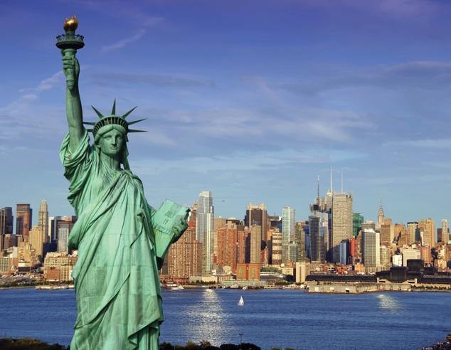
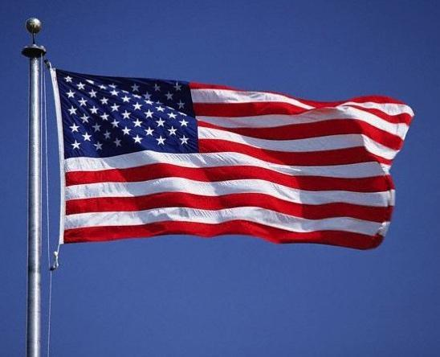
National Symbols
**Section ‘A’ on your fill in the blanks worksheet

Slide 7
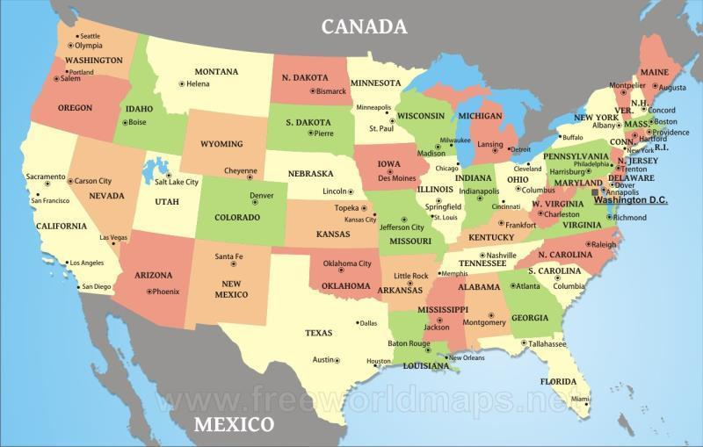
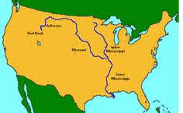
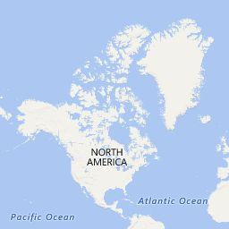
Geography/Maps
**Section ‘B’ on your fill in the blanks worksheet

Slide 8
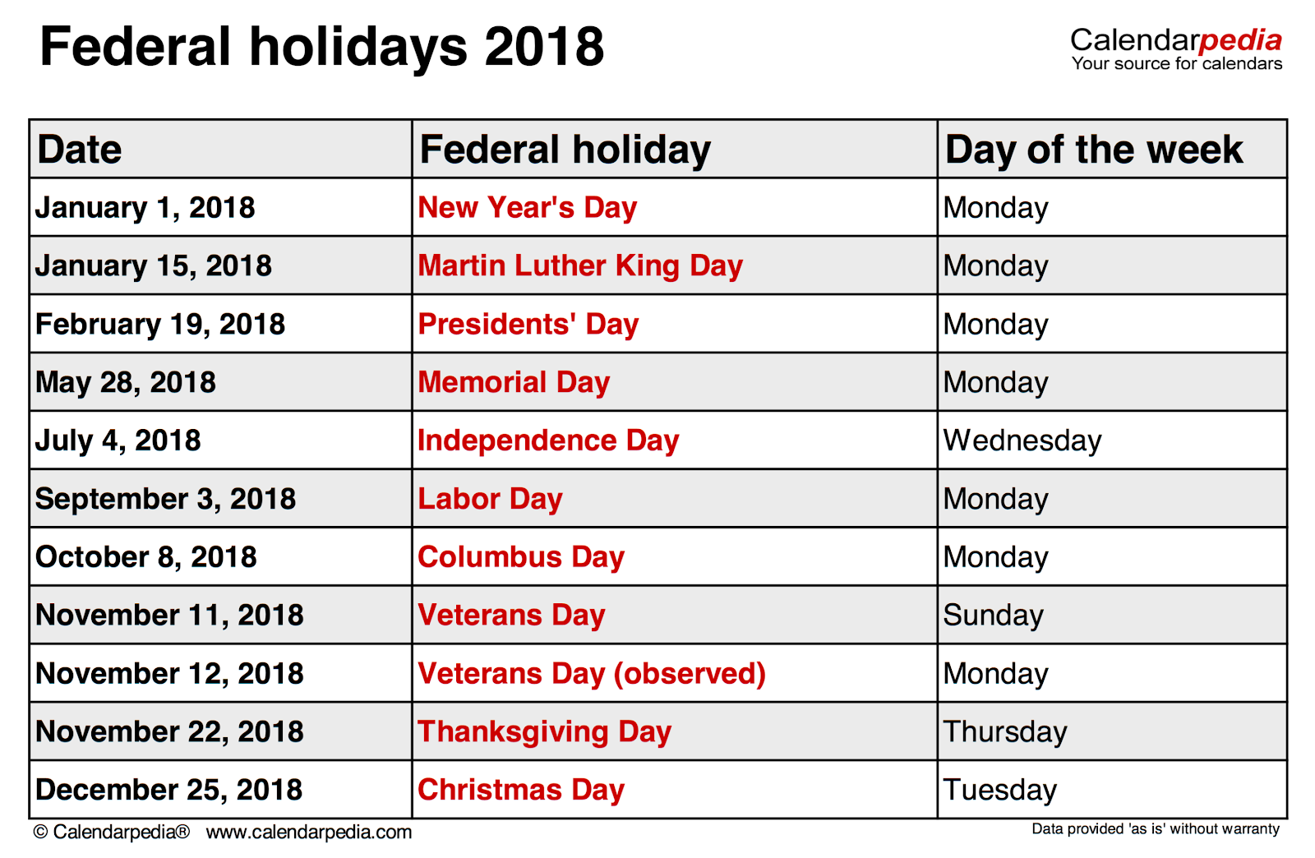
Holidays
**Section ‘C’ on your fill in the blanks worksheet

Slide 9
What we Learned in Session 2

Slide 10
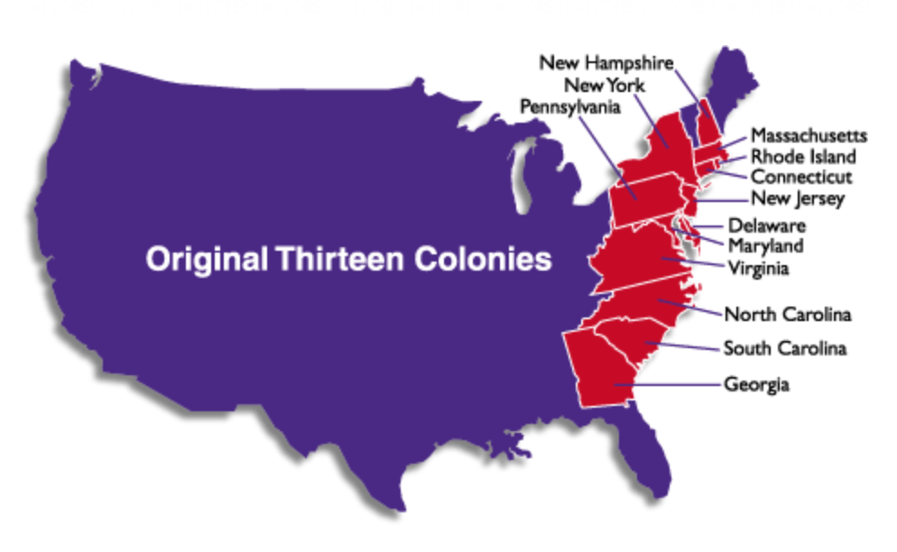
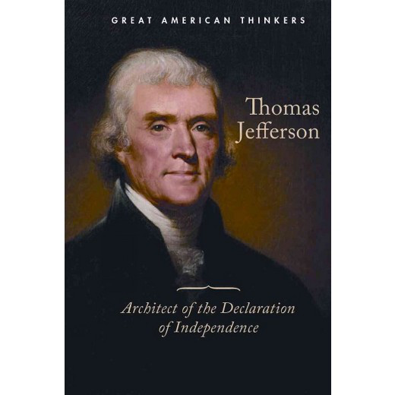
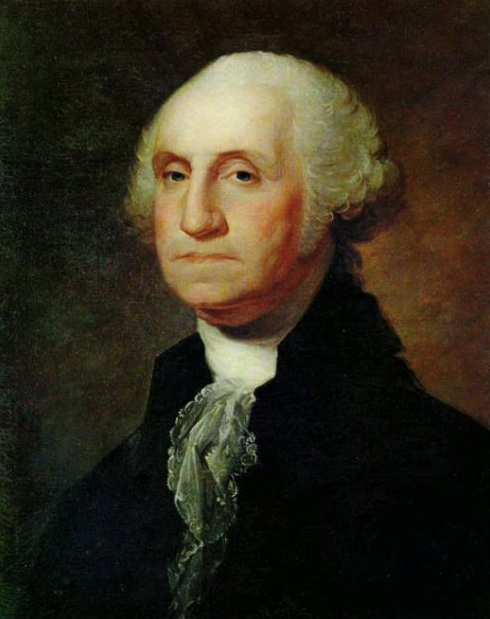
Early United States History
**Section ‘D’ on your fill in the blanks worksheet

Slide 11
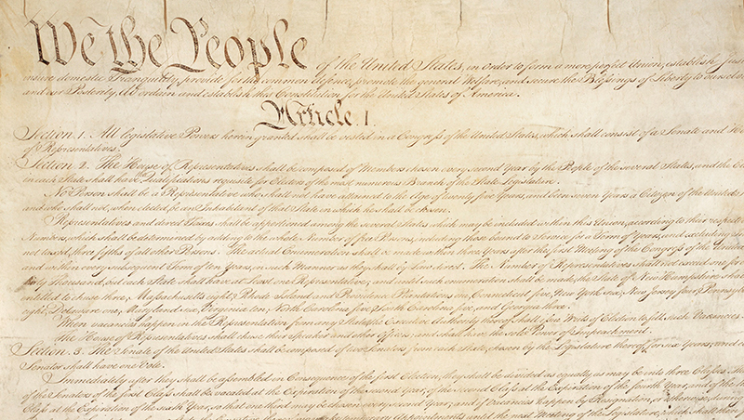
Early United States History
**Section ‘D’ on your fill in the blanks worksheet

Slide 12
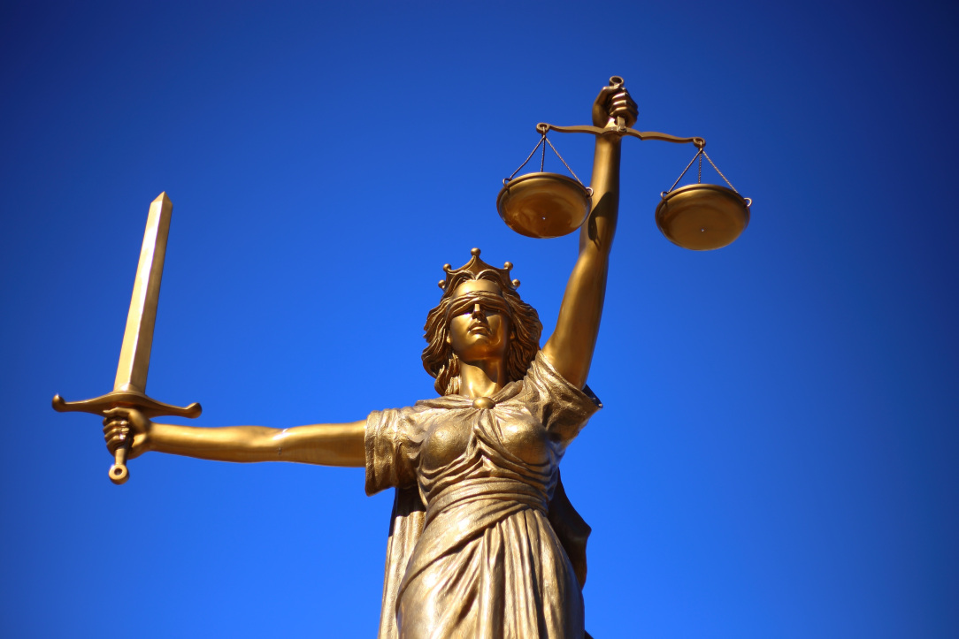
Early United States History
P - Press
A - Assembly
P - Petition
R - Religion
S - Speech
**Section ‘D’ on your fill in the blanks worksheet

Slide 13
Fill in the Blank Questions
Section A:
The _________________ is located on Liberty Island in New York.
On the United States flag, the ______________ represent the original colonies and the ______________ represent the states.

Slide 14
Fill in the Blank Questions
Section B:
Washington is a state that borders ________________.
Texas is a state that borders ________________.
The Mississippi River is one of the ____________ rivers in the United States.
The ____________ Ocean is to the west of the United States, and the ____________ Ocean is to the east.

Slide 15
Fill in the Blank Questions
Section C:
Independence Day is celebrated every year on _____________________.
In November, we celebrate ________________________.

Slide 16
Fill in the Blank Questions
Section D:
New York, Pennsylvania, and Delaware were three of the thirteen ______________________________________.
________________________ wrote the Declaration of Independence.
The first president of the United States was _____________________________.
The __________________ is the supreme law of the land.

Slide 17
Fill in the Blank Questions
Section D:
5. The first ten amendments to the Constitution are called the _______________________________.
6. The acronym ‘PAPRS’ is used to remember the freedoms contained in the ___________________________. Those freedoms are: Press, Assembly, Petition, Religion, and Speech.
7. No one is above the law is the main idea behind the foundation of _______________________________.

Slide 18
Answers to Session 1 and 2 Review
Section A:
Statue of Liberty
stripes; stars
Section B:
Canada
Mexico
longest
Pacific; Atlantic
Section C:
July 4
Thanksgiving
Section D:
Original Colonies
Thomas Jefferson
George Washington
Constitution
Bill of Rights
First Amendment
Rule of Law

Slide 19
End of Review!
**Once you feel confident with Sessions 1 and 2, and have completed this video, move onto Session 3!

