Slide 1
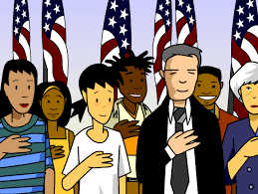
Citizenship Class
Session 7: Citizenship Rights and Responsibilities

Slide 2
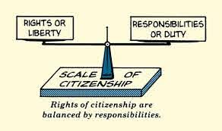
What is the difference between a right and a responsibility?
A right is a freedom that is protected, such as the right to free speech and religion.
A responsibility is a duty or something you should do, such as voting or doing your homework.

Slide 3
Rights and Responsibilities of Everyone

Slide 4
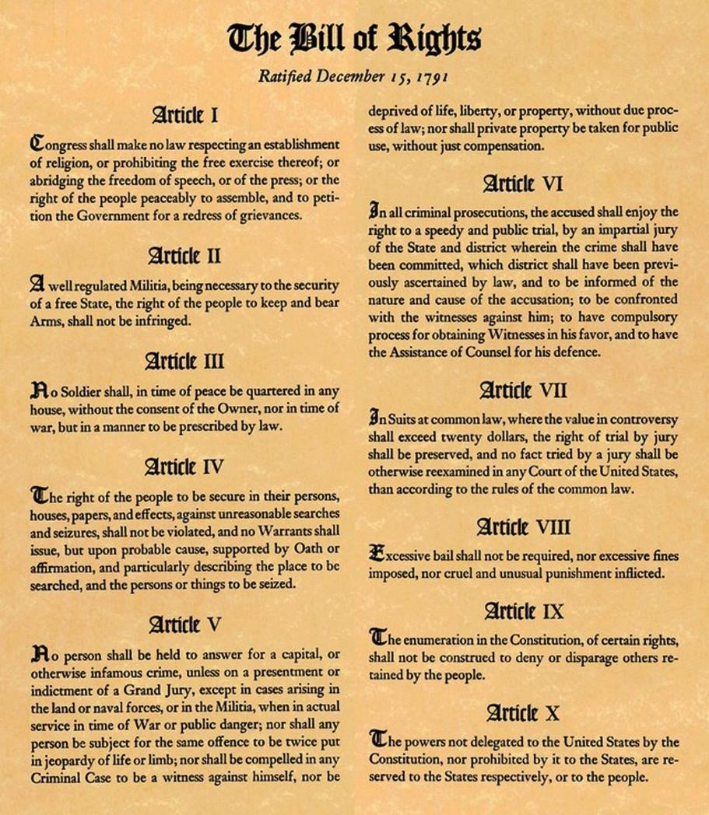
Rights of Everyone in the United States
The first 10 amendments of the Constitution are known as the Bill of Rights. The Bill of Rights protects everyone’s (including non-citizens!!) basic freedoms including freedom of expression, freedom of speech, freedom of assembly, freedom of religion, and the right to bear arms.

Slide 5
Rights of Everyone in the United States
The first 10 amendments of the Constitution are known as the Bill of Rights. The Bill of Rights protects everyone’s (including non-citizens!!) basic freedoms including freedom of expression, freedom of speech, freedom of assembly, freedom of religion, and the right to bear arms.
Question #1

Slide 6
Responsibility - Register for Selective Service
All males between ages 18 and 25 must register with the Selective Service System (SSS).
Immigrant males between the ages of 18 and 25 must register within 30 days of arriving in the United States.

Slide 7
Responsibility - Register for Selective Service
All males between ages 18 and 25 must register with the Selective Service System (SSS).
Immigrant males between the ages of 18 and 25 must register within 30 days of arriving in the United States.
Question #2

Slide 8
Responsibility - Pay Taxes
In the United States, federal income tax is collected by the Internal Revenue Service (IRS).
The tax year is January 1 to December 31. You must file a federal income tax return by April 15 each year, or by the deadline following April 15 when it falls on a weekend.

Slide 9
Responsibility - Pay Taxes
In the United States, federal income tax is collected by the Internal Revenue Service (IRS).
The tax year is January 1 to December 31. You must file a federal income tax return by April 15 each year, or by the deadline following April 15 when it falls on a weekend.
Question #3

Slide 10
Becoming Loyal to the United States

Slide 11
Citizenship Oath
I hereby declare, on oath,
that I absolutely and entirely renounce and abjure all allegiance and fidelity to any foreign prince, potentate, state, or sovereignty, of whom or which I have heretofore been a subject or citizen;
that I will support and defend the Constitution and laws of the United States of America against all enemies, foreign and domestic;
that I will bear true faith and allegiance to the same;
Give up loyalty to other countries
Defend the Constitution
Obey U.S. laws

Slide 12
Citizenship Oath (continued)
that I will bear arms on behalf of the United States when required by the law;
that I will perform noncombatant service in the Armed Forces of the United States when required by the law;
that I will perform work of national importance under civilian direction when required by the law;
and that I take this obligation freely, without any mental reservation or purpose of evasion; so help me God.
Serve in the military if needed

Slide 13
Promises made in the Citizenship Oath
Give up loyalty to other countries
Defend the Constitution
Obey the laws of the United States
Serve in the military if needed
Question #4

Slide 14
Pledge of Allegiance
I pledge allegiance to the flag
of the United States of America,
and to the Republic for which it stands,
one Nation under God, indivisible,
with liberty and justice for all.

Slide 15
Pledge of Allegiance
I pledge allegiance to the flag
of the United States of America,
and to the Republic for which it stands,
one Nation under God, indivisible,
with liberty and justice for all.
Question #5

Slide 16
Rights and Responsibilities of Citizens

Slide 17
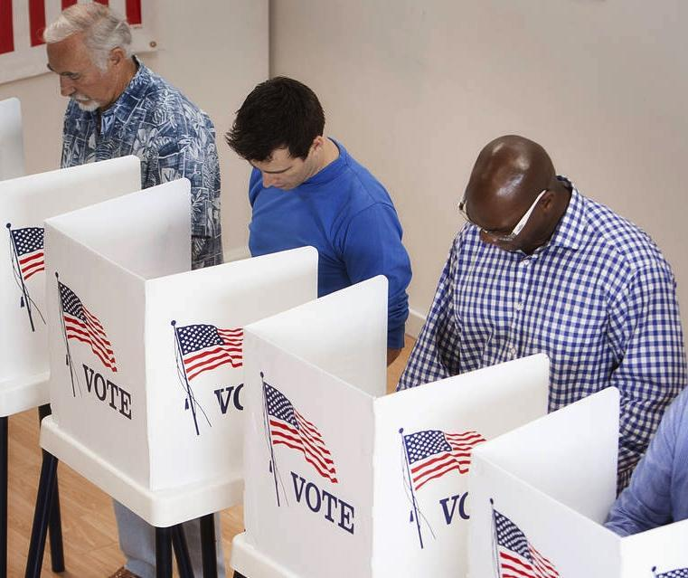
Citizenship Responsibilities
The duties or responsibilities of a United States citizen include: pay taxes, serve on a jury, and register for Selective Service. It is required by law that citizens do these things.
Another responsibility of citizens is voting, although it is not required.

Slide 18
Citizenship Responsibilities
The duties or responsibilities of a United States citizen include: pay taxes, serve on a jury, and register for Selective Service. It is required by law that citizens do these things.
Another responsibility of citizens is voting, although it is not required.
Question #6

Slide 19
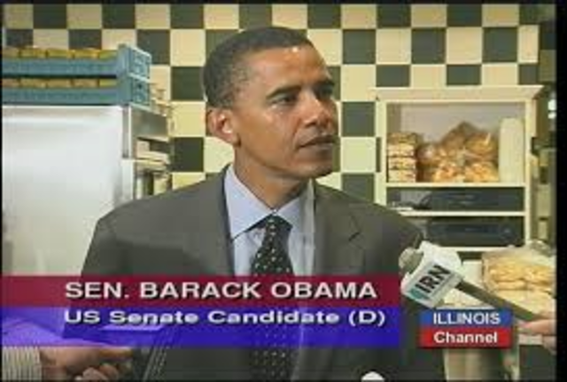
Rights of United States Citizens
Basic rights are guaranteed to everyone in the United States (even non-citizens) in the Constitution. Citizens have additional rights.
These additional rights for citizens are the right to vote in federal elections and the right to run for office.

Slide 20
Rights of United States Citizens
Basic rights are guaranteed to everyone in the United States (even non-citizens) in the Constitution. Citizens have additional rights.
These additional rights for citizens are the right to vote in federal elections and the right to run for office.
Question #7

Slide 21
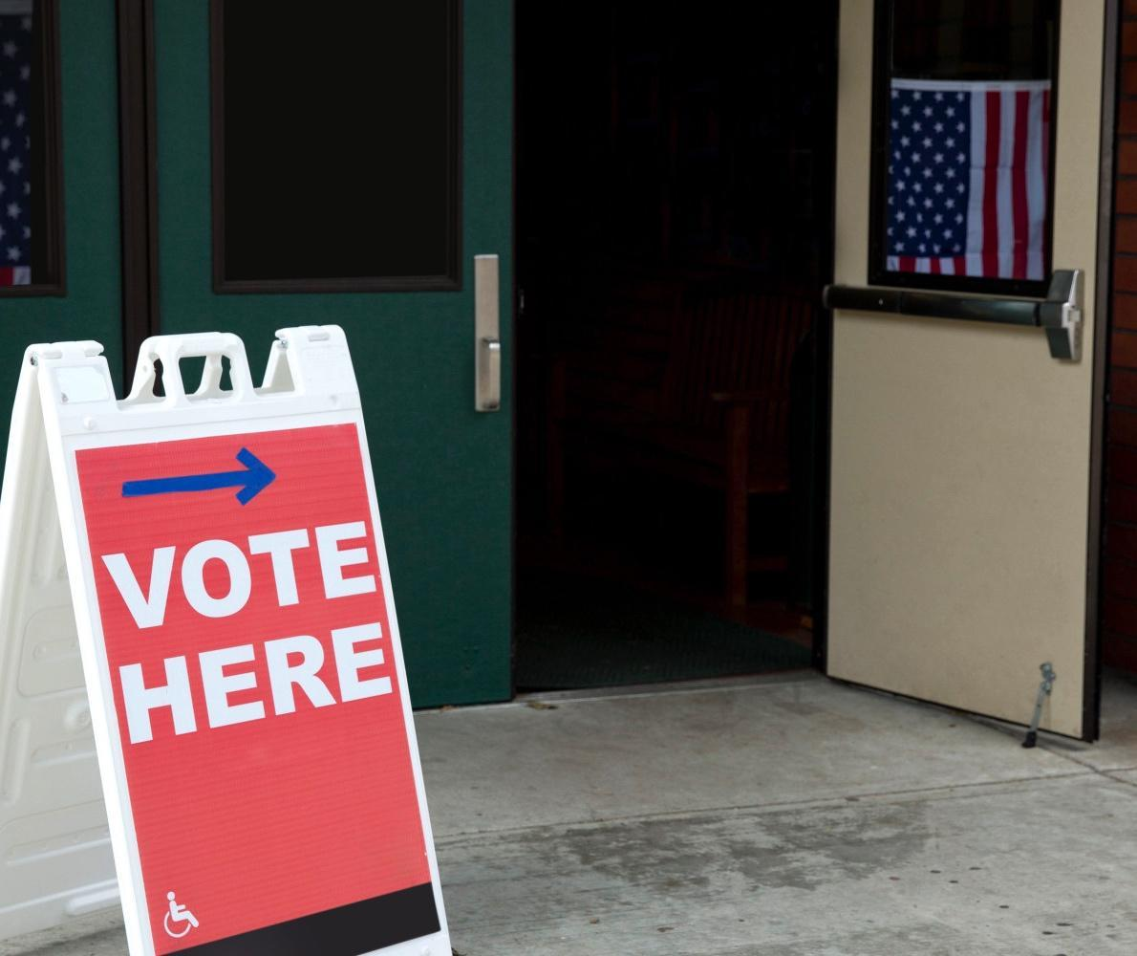
The Right to Vote
You are eligible to vote in federal elections if:
You are a U.S. citizen (either by birth or naturalization)
You meet your state’s residency requirements
You are 18 years old
You are a registered voter
The process to vote is simple and there is no cost.

Slide 22
The Right to Vote
You are eligible to vote in federal elections if:
You are a U.S. citizen (either by birth or naturalization)
You meet your state’s residency requirements
You are 18 years old
You are a registered voter
The process to vote is simple and there is no cost.
Question #8

Slide 23
Political Parties and Participating in Democracy

Slide 24
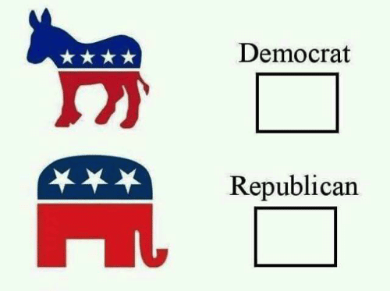
American Political Parties
A political party is a group of people with similar political views and interests that work together to influence elections and political decisions.
Political parties:
Select and support candidates
Encourage people to participate and vote
Monitor and report on political issues
Today’s biggest parties are the Democrats and the Republicans. These parties are often associated with colors, blue for Democrats and red for Republicans; and animal symbols, donkey for Democrats and elephant for Republicans. The Republican Party is also known as the GOP, which stands for ‘Grand Old Party’.

Slide 25
American Political Parties
A political party is a group of people with similar political views and interests that work together to influence elections and political decisions.
Political parties:
Select and support candidates
Encourage people to participate and vote
Monitor and report on political issues
Today’s biggest parties are the Democrats and the Republicans. These parties are often associated with colors, blue for Democrats and red for Republicans; and animal symbols, donkey for Democrats and elephant for Republicans. The Republican Party is also known as the GOP, which stands for ‘Grand Old Party’.
Question #9

Slide 26
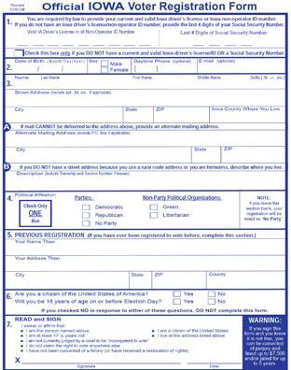
Ways to Participate in Democracy
As a citizen, you can make a big difference. Some things you can do to be politically active include:
Register to vote
Vote in every election (local, state, and federal)
Vote in primaries
Join a political party
Ask questions of candidates and elected officials
Run for office

Slide 27
Ways to Participate in Democracy
As a citizen, you can make a big difference. Some things you can do to be politically active include:
Register to vote
Vote in every election (local, state, and federal)
Vote in primaries
Join a political party
Ask questions of candidates and elected officials
Run for office
Question #10

Slide 28
WORKSHEET REVIEW
1. Freedom of expression/speech/assembly/religion; right to bear arms
2. Between ages 18 and 25
3. April 15
4. Give up loyal to other countries/defend the Constitution/obey the laws of the United States/serve in military if needed
5. The flag/the United States
6. Pay taxes/serve on a jury/register for Selective Service/vote
7. Vote in federal elections/run for office
8. 18
9. Democrats and Republicans
10. Register to vote/vote/vote in primaries/join political party/ask elected officials questions/run for office

Slide 29
Dictation Practice
We pay taxes in April.
Citizens have the right to run for office.
I want to be an American citizen.

Slide 30
WHAT TO DO NOW
Writing Practice
Write out the eight sentences
Practice saying them out loud
Reading Practice
Practice reading sentences
Read out loud!!

Slide 31
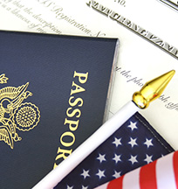
Class is Complete!
Sessions 1-7 cover all the material that is on the Civics Test
The next video series will explain how to fill out the application for citizenship and explain what will happen during the citizenship interview

Slide 32
IF YOU HAVE ANY QUESTIONS
Call the Columbus Junction Public Library: 319-728-7972
Email Mandy Grimm at: mandy.grimm@columbusjct.lib.ia.us

