Slide 1
Citizenship Class
Session 6: 1900s History

Slide 2
Review - People Questions
Who is the governor of Iowa?
Who wrote the Declaration of Independence?
Who signs a bill to make it a law?
Name one of Iowa’s senators.
Name your U.S. representative.
Kim Reynolds
Thomas Jefferson
The President
Chuck Grassley/Joni Ernst
Mariannette Miller-Meeks

Slide 3
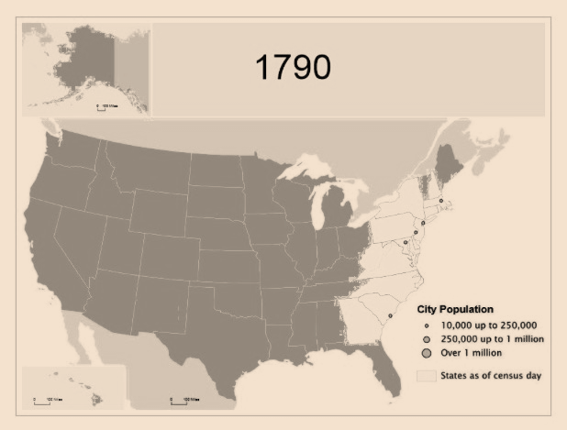
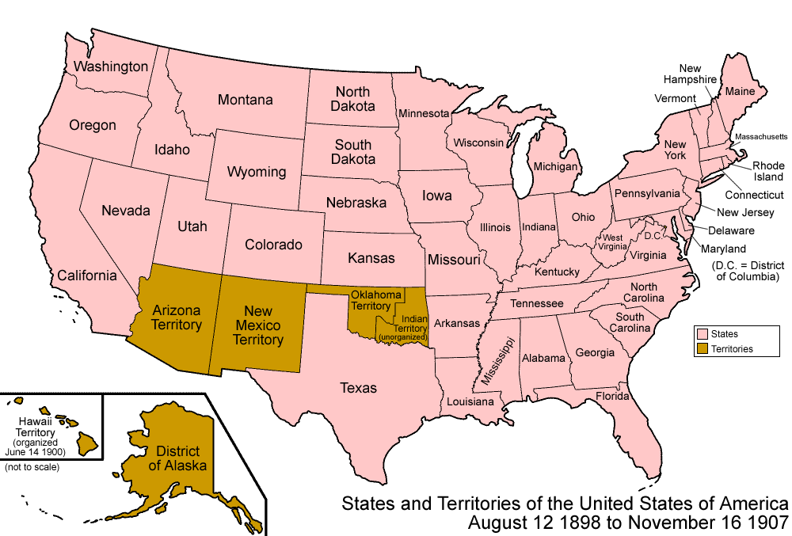
Beginning the 1900s
1790:
14 states
Population: 3,231,533
1900:
45 states
Population: 76,212,189
8,000 cars in the whole country; none west of the Mississippi

Slide 4
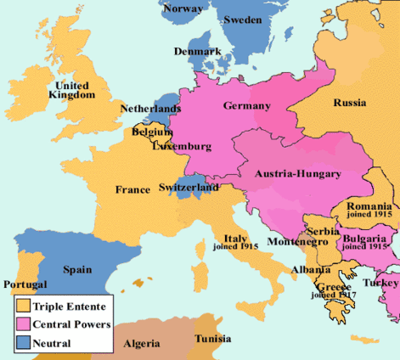
World War I
World War I, or The Great War, began in Europe in 1914.
The United States joined the war in 1917 when an American ship was attacked by Germany. The United States joined the Allies which included England, France, and Russia. They fought the Central Powers, which were Germany, Austria-Hungary, and Turkey.
World War I ended in 1918. Woodrow Wilson served as president from 1913 to 1921, and led the United States during World War I.

Slide 5
World War I
World War I, or The Great War, began in Europe in 1914.
The United States joined the war in 1917 when an American ship was attacked by Germany. The United States joined the Allies which included England, France, and Russia. They fought the Central Powers, which were Germany, Austria-Hungary, and Turkey.
World War I ended in 1918. Woodrow Wilson served as president from 1913 to 1921, and led the United States during World War I.
Question #1

Slide 6
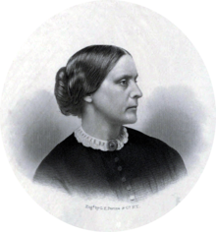
Women Get the Right to Vote
In 1920, the 19th Amendment was passed. It guaranteed a citizen’s right to vote, regardless of gender. Up until now, women could not vote.
The campaign for women to have the right to vote began before the Civil War. The effort was known as the women’s suffrage movement.
Susan B. Anthony spoke in Columbus Junction in February, 1876.
In 1851, Susan B, Anthony joined the movement and fought for women’s rights. In 1869, she founded the National Woman Suffrage Association. Anthony died in 1906, and she is recognized because she helped women get the right to vote.

Slide 7
Women Get the Right to Vote
In 1920, the 19th Amendment was passed. It guaranteed a citizen’s right to vote, regardless of gender. Up until now, women could not vote.
The campaign for women to have the right to vote began before the Civil War. The effort was known as the women’s suffrage movement.
Susan B. Anthony spoke in Columbus Junction in February, 1876.
In 1851, Susan B, Anthony joined the movement and fought for women’s rights. In 1869, she founded the National Woman Suffrage Association. Anthony died in 1906, and she is recognized because she helped women get the right to vote.
Question #2

Slide 8
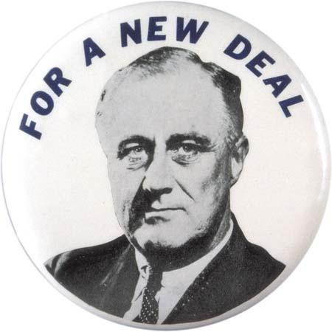
The Great Depression and The New Deal
In the 1930s, the United States had many economic problems. This period is known as The Great Depression. Businesses and banks closed, and people lost their homes, jobs, and savings.
Franklin Delano Roosevelt, known as FDR, was elected president in 1932. He had a plan for rebuilding the country called “The New Deal”. The plan put people to work building public projects. It also established the minimum wage, Social Security, and many welfare programs still used today.
FDR was President from 1933 to 1945. FDR led the country during the Great Depression and World War II.

Slide 9
The Great Depression and The New Deal
In the 1930s, the United States had many economic problems. This period is known as The Great Depression. Businesses and banks closed, and people lost their homes, jobs, and savings.
Franklin Delano Roosevelt, known as FDR, was elected president in 1932. He had a plan for rebuilding the country called “The New Deal”. The plan put people to work building public projects. It also established the minimum wage, Social Security, and many welfare programs still used today.
FDR was President from 1933 to 1945. FDR led the country during the Great Depression and World War II.
Question #3

Slide 10
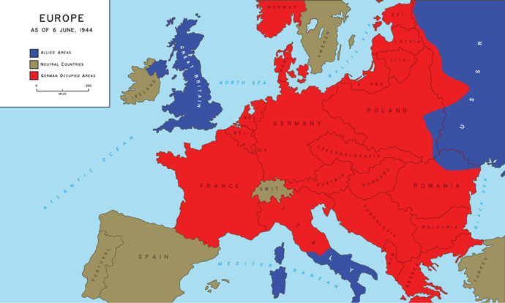
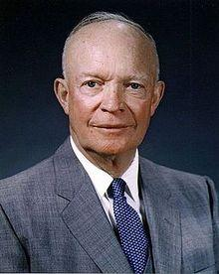
World War II
World War II began in 1939. The United States joined in 1941 after the bombing of Pearl Harbor. The two sides were the Allies: U.S. England, France, and Russia; and the Axis Powers: Germany, Italy, and Japan. 23 other countries support either the Allies or the Axis.
The U.S. Army was led in World War II by General Dwight D. Eisenhower, who later was elected president.
In 1943, Italy surrendered to the Allies. World War II ended in 1945 after Germany surrendered in May and Japan in August.

Slide 11
World War II
World War II began in 1939. The United States joined in 1941 after the bombing of Pearl Harbor. The two sides were the Allies: U.S. England, France, and Russia; and the Axis Powers: Germany, Italy, and Japan. 23 other countries support either the Allies or the Axis.
The U.S. Army was led in World War II by General Dwight D. Eisenhower, who later was elected president.
In 1943, Italy surrendered to the Allies. World War II ended in 1945 after Germany surrendered in May and Japan in August.
Question #4 and #5

Slide 12
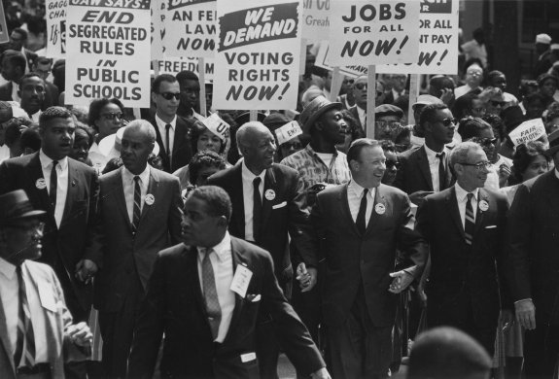
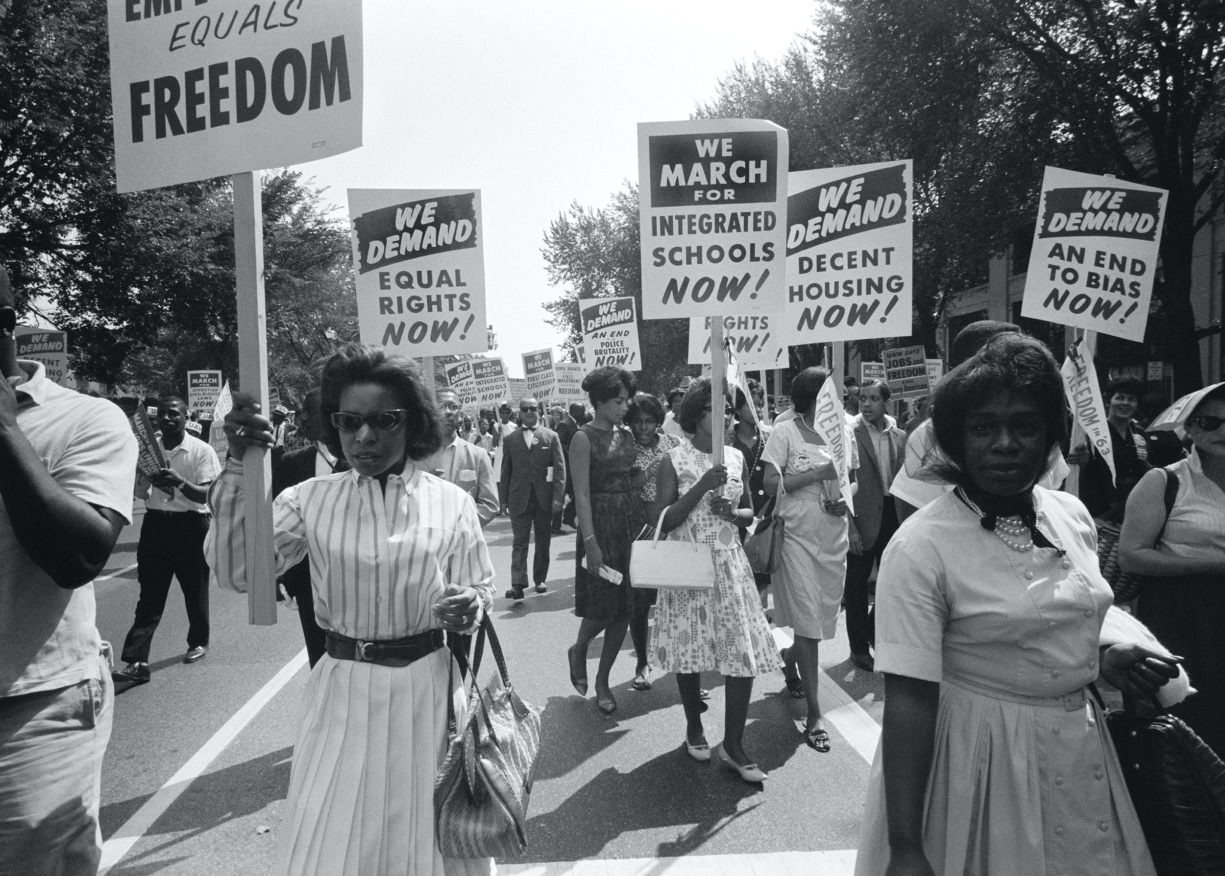
The Civil Rights Movement - 1950s and 1960s
Since the time of slavery, African Americans have fought for civil rights and equal treatment. The Civil Rights Movement tried to end racial discrimination. One Civil Rights movement leader was Dr. Martin Luther King , Jr.

Slide 13
The Civil Rights Movement - 1950s and 1960s
Since the time of slavery, African Americans have fought for civil rights and equal treatment. The Civil Rights Movement tried to end racial discrimination. One Civil Rights movement leader was Dr. Martin Luther King , Jr.
Question #6

Slide 14
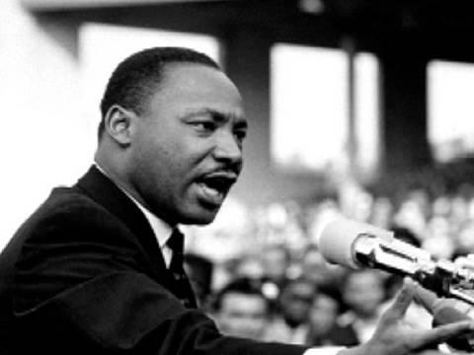
Martin Luther King, Jr.
Martin Luther King Jr. fought for equal rights and freedom for all Americans.
In his famous “I Have a Dream” speech, Dr. King said: “I have a dream that my four little children will one day live in a nation where they will not be judged by the color of their skin, but by the content of their character.”
Dr. King was assassinated in 1968. His birthday is a
national holiday, and is celebrated on the third Monday in January.

Slide 15
Martin Luther King, Jr.
Martin Luther King Jr. fought for equal rights and freedom for all Americans.
In his famous “I Have a Dream” speech, Dr. King said: “I have a dream that my four little children will one day live in a nation where they will not be judged by the color of their skin, but by the content of their character.”
Dr. King was assassinated in 1968. His birthday is a
national holiday, and is celebrated on the third Monday in January.
Question #7

Slide 16
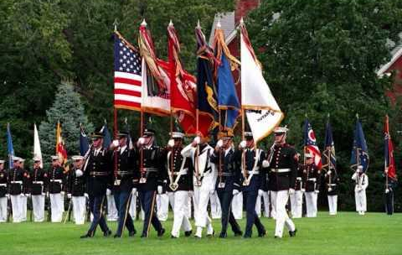
United States Wars
1900s:
World War I (WWI)
World War II (WWII)
Korean War
Vietnam War
Gulf War
1800s:
War of 1812
Mexican-American War
Civil War
Spanish American War

Slide 17
United States Wars
1900s:
World War I (WWI)
World War II (WWII)
Korean War
Vietnam War
Gulf War
1800s:
War of 1812
Mexican-American War
Civil War
Spanish American War
Question #8

Slide 18
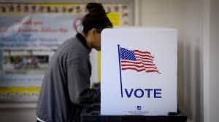
Amendments Regarding the Right to Vote
15th Amendment - passed 1870
The right to vote cannot be denied based on race, color, or servitude
Former slaves got the right to vote; men of all races could vote
19th Amendment - passed 1920
The right to vote cannot be denied based on sex
Women got the right to vote
24th Amendment - passed 1964
The right to vote cannot be denied by failure to pay a poll tax
26th Amendment - passed 1971
Set the age for the right to vote at 18

Slide 19
Amendments Regarding the Right to Vote
15th Amendment - passed 1870
The right to vote cannot be denied based on race, color, or servitude
Former slaves got the right to vote; men of all races could vote
19th Amendment - passed 1920
The right to vote cannot be denied based on sex
Women got the right to vote
24th Amendment - passed 1964
The right to vote cannot be denied by failure to pay a poll tax
26th Amendment - passed 1971
Set the age for the right to vote at 18
Question #9

Slide 20
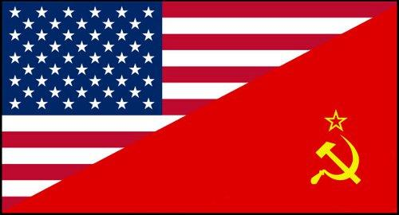
The Cold War
The U.S. and Russia were allies during World War II. After the war, they became competing superpowers.
Russia was the leader of the Soviet Union, or USSR. The Soviets wanted to spread communism to Eastern Europe and the rest of the world. The United States wanted to stop the spread of communism.
The Cold War was a war of words and military power, but had no actual fighting. In 1970, both nations began building nuclear weapons for protection. In 1991, the Soviet Union fell apart, the Berlin Wall was destroyed, and the Cold War was over.

Slide 21
The Cold War
The U.S. and Russia were allies during World War II. After the war, they became competing superpowers.
Russia was the leader of the Soviet Union, or USSR. The Soviets wanted to spread communism to Eastern Europe and the rest of the world. The United States wanted to stop the spread of communism.
The Cold War was a war of words and military power, but had no actual fighting. In 1970, both nations began building nuclear weapons for protection. In 1991, the Soviet Union fell apart, the Berlin Wall was destroyed, and the Cold War was over.
Question #10

Slide 22
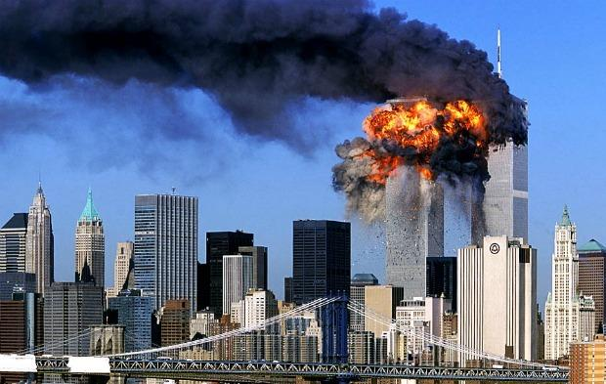
September 11th, 2001
On September 11, 2001, commonly called 9/11, terrorists attacked the United States.
Terrorists took control of four U.S. airplanes to use for suicide attacks. Two planes hit the World Trade Center in New York City. One plane crashed into the west wing of the Pentagon in Washington, D.C. The fourth plane did not make it to the intended target, as passengers heroically crashed the plane into a field.
A total of 2,996 people were killed in the 9/11 attacks.

Slide 23
September 11th, 2001
On September 11, 2001, commonly called 9/11, terrorists attacked the United States.
Terrorists took control of four U.S. airplanes to use for suicide attacks. Two planes hit the World Trade Center in New York City. One plane crashed into the west wing of the Pentagon in Washington, D.C. The fourth plane did not make it to the intended target, as passengers heroically crashed the plane into a field.
A total of 2,996 people were killed in the 9/11 attacks.
Question #11

Slide 24
WORKSHEET REVIEW
1. Woodrow Wilson
2. Fought for women’s rights/helped women get the right to vote
3. Franklin Delano Roosevelt/FDR
4. Axis Powers/Germany, Italy, and Japan
5. World War II
6. Civil Rights Movement
7. Fought for equal rights
8. World War I/World War II/Korean War/Vietnam War/Gulf War
9. 15th - men of all races could vote/19th - women can vote/24th - don’t have to pay a poll tax/26th - you can vote at age 18
10. Stop the spread of communism
11. Terrorists attacked the United States

Slide 25
Dictation Practice
Any citizen can vote once they are 18 years old.
The attack on the World Trade Center happened on September 11, 2001.
Communism was the main concern of the Cold War.

Slide 26
WHAT TO DO BEFORE NEXT SESSION
Writing Practice
Write out the eight sentences
Practice saying them out loud
Reading Practice
Practice reading ‘World War II’
Read out loud!!

Slide 27
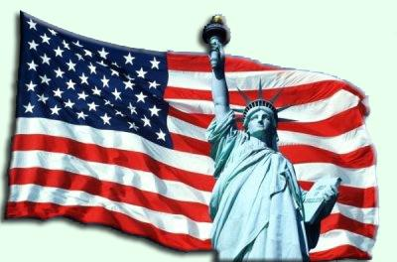
NEXT CLASS -- Citizenship Rights and Responsibilities, Application and Interview

Slide 28
IF YOU HAVE ANY QUESTIONS
Call the Columbus Junction Public Library: 319-728-7972
Email Many Grimm at: mandy.grimm@columbusjct.lib.ia.us

